Slide 1

ADITYA ENGINEERING COLLEGE (A)
OOPS Through JAVA
By
N.Akhila
Sr.Asst.Professor
Dept of Computer Science and Engineering
Aditya Engineering College(A)
Surampalem.

Slide 2
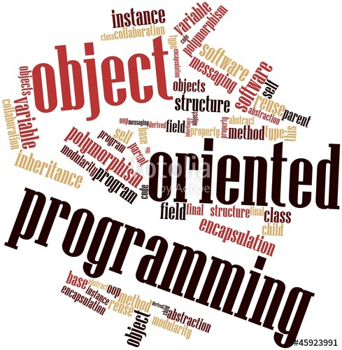
Why do we need OOP?

Slide 3
Introduction to POP
A program in a procedural language is a list of instruction where each statement tells the computer to do something. It focuses on procedure (function) & algorithm is needed to perform the derived computation.
When program become larger, it is divided into function & each function has clearly defined purpose. Dividing the program into functions is one of the cornerstones of structured programming.
Examples of Procedural languages BASIC, C, Pascal, FORTRAN

Slide 4
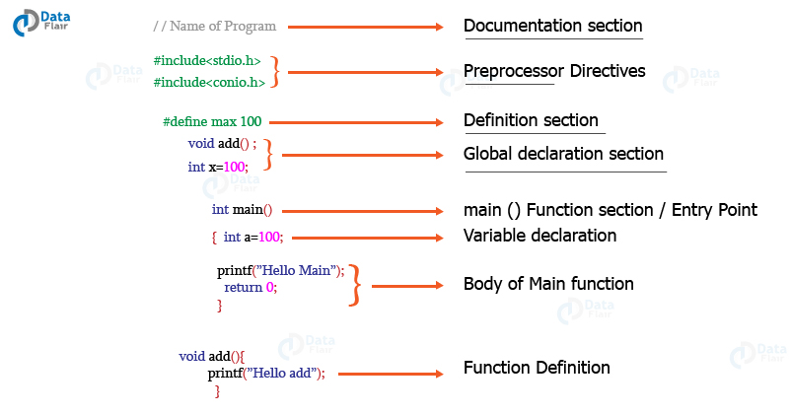

Slide 5
Characteristics of POP
It focuses on functions rather than data.
A program is divided into a number of functions and each function has clearly defined purpose.
Most of the functions share global data.
Data moves openly around the system from function to function.

Slide 6
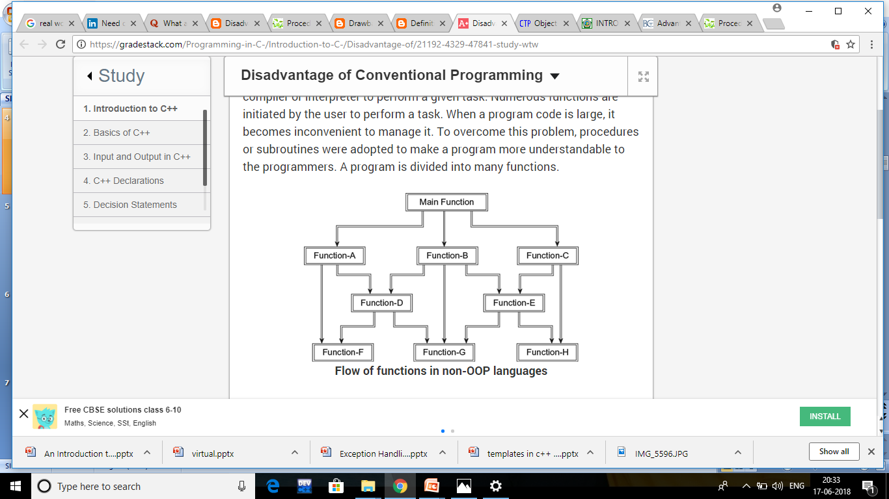

Slide 7
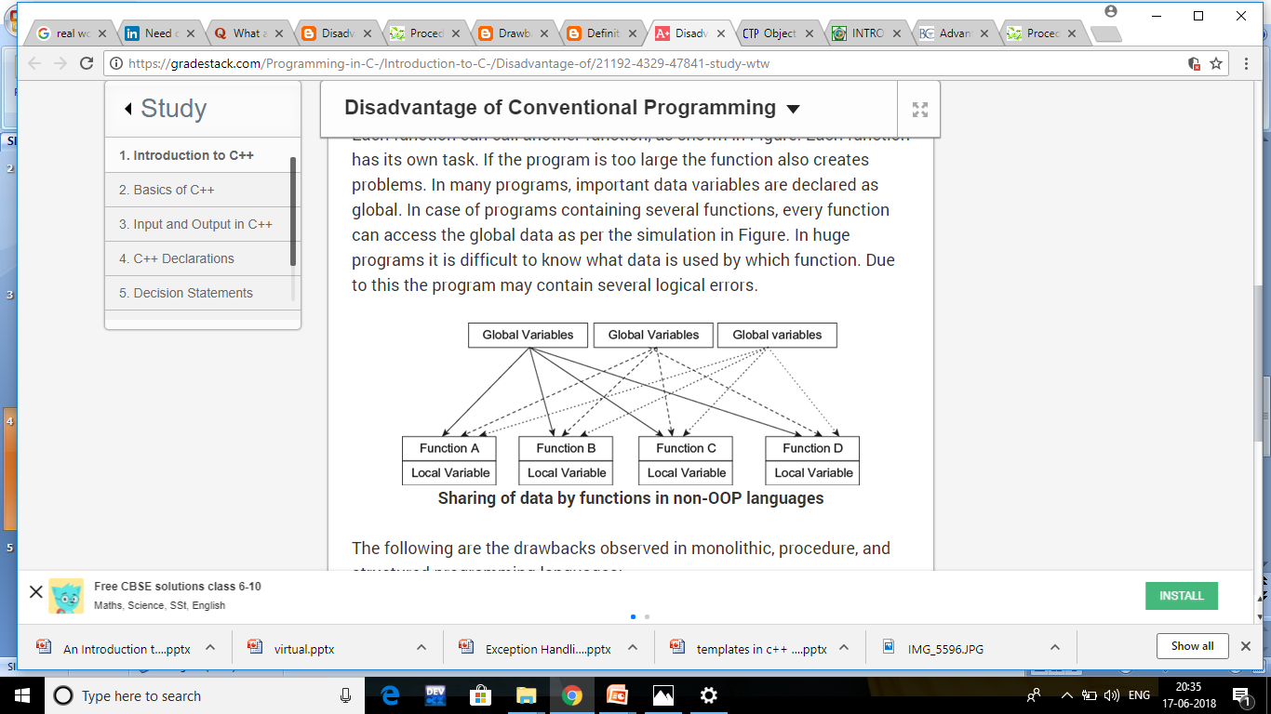

Slide 8
Drawback of POP
Concentrates mainly on functions, but not data.
Functions shares global data.
No security to data- data moves openly among the functions.
Function transforms data from one form to another

Slide 9
OBJECT
Object is a instance of class,
Object means a real world entity such as pen, chair, table etc.
Object has state and behaviours.
state: represents data (value) of an object.
behavior: represents the functionality.

Slide 10
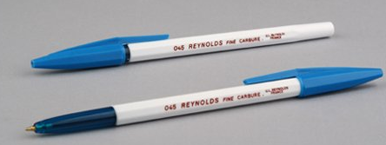
Examples
EX:
Pen is an object. Its name is Reynolds, color is white etc. known as its state. It is used to write, so writing is its behaviour.
program is made up of too small programs called object

Slide 11
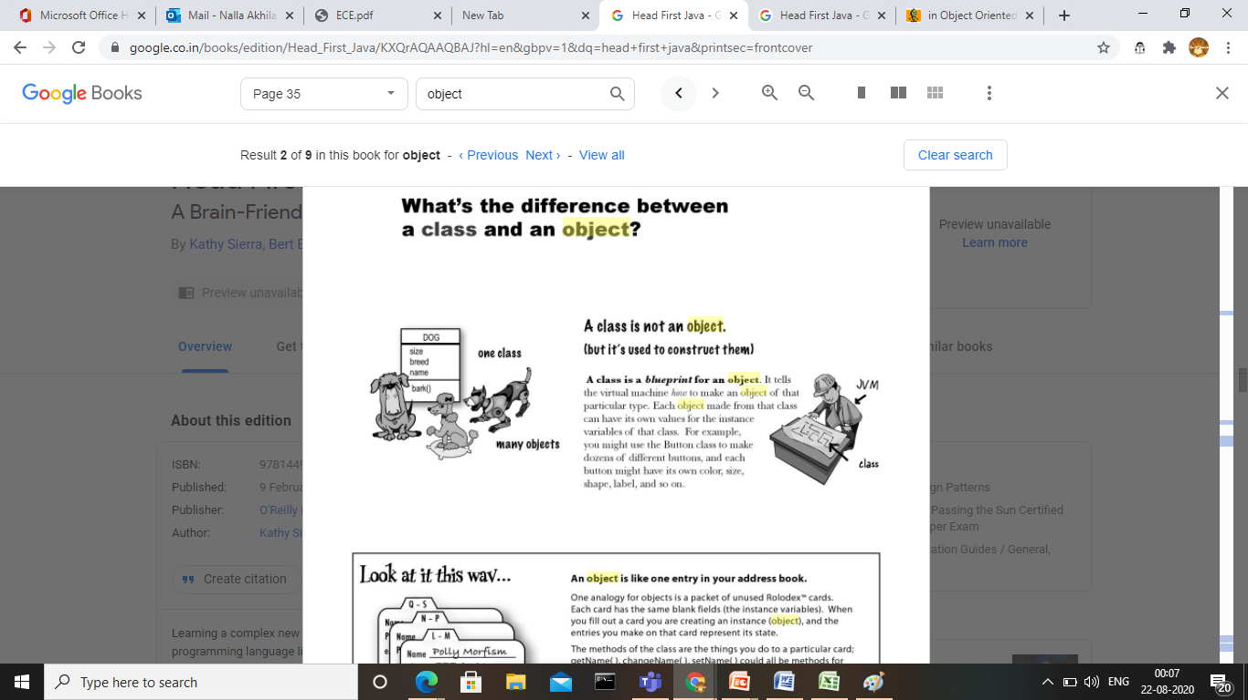

Slide 12
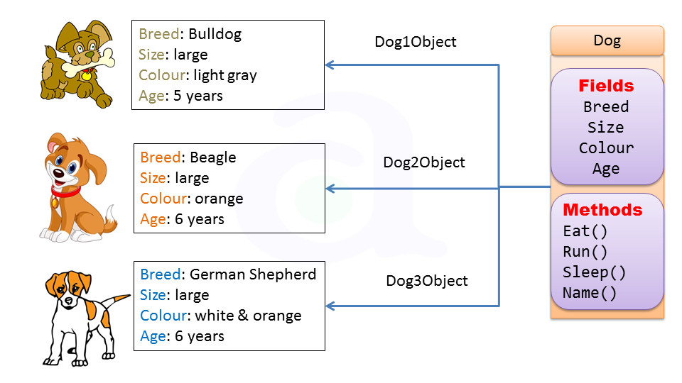

Slide 13
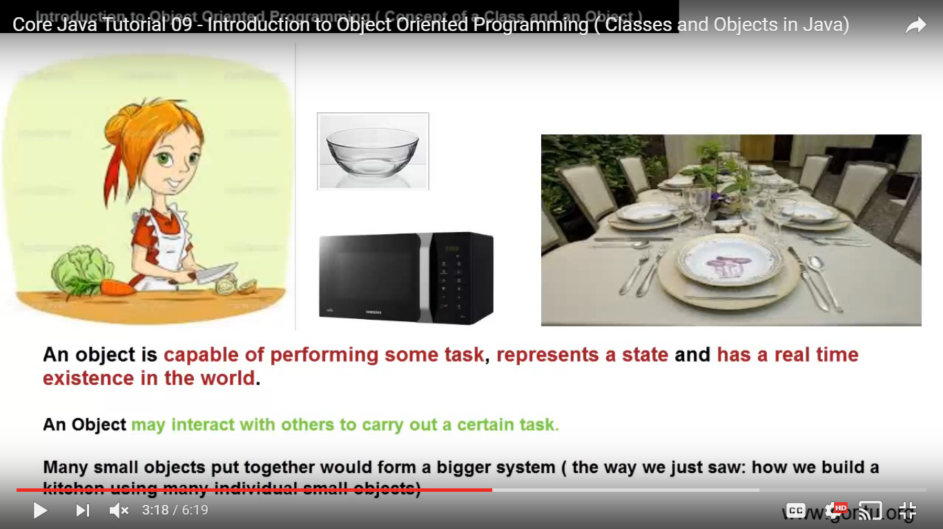
contd

Slide 14
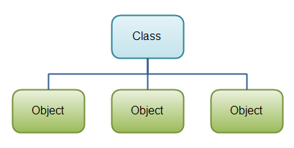
CLASS
A class is a group of objects that has common properties. It is a template or blueprint from which objects are created.

Slide 15
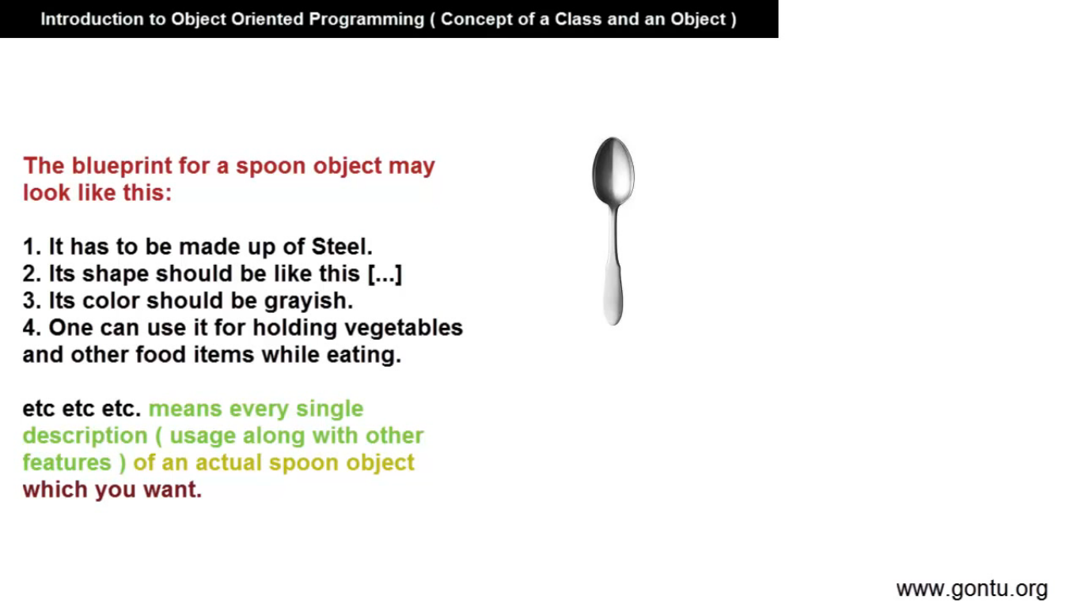
Ex:

Slide 16
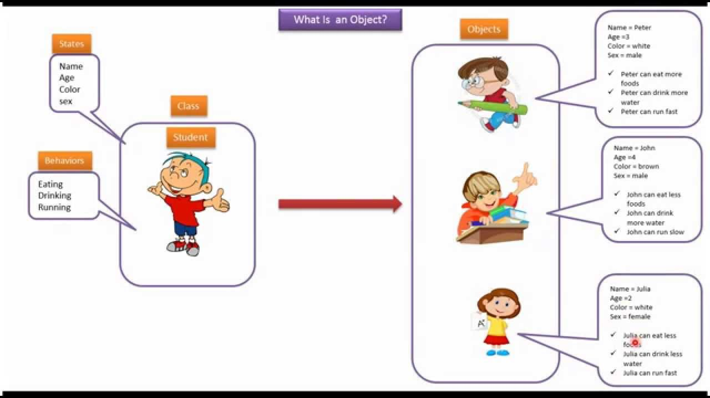

Slide 17
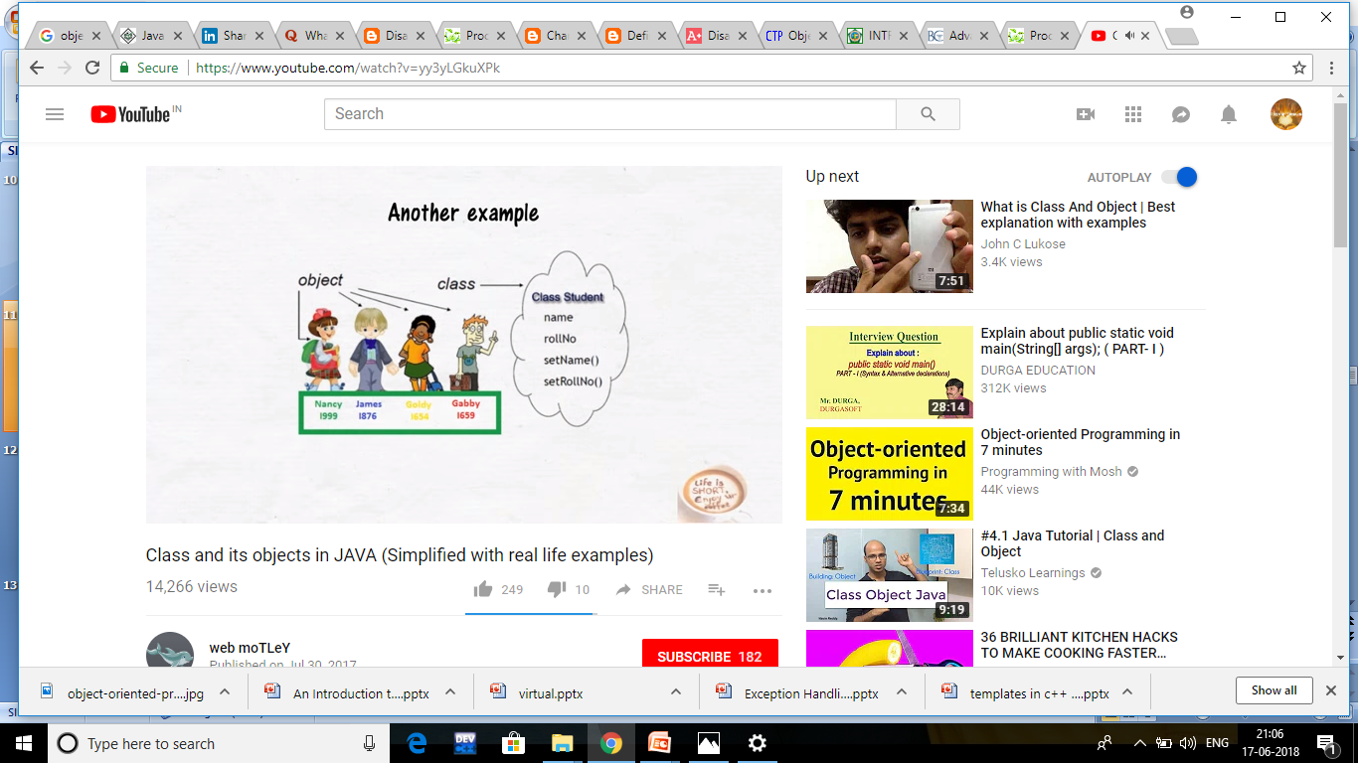

Slide 18
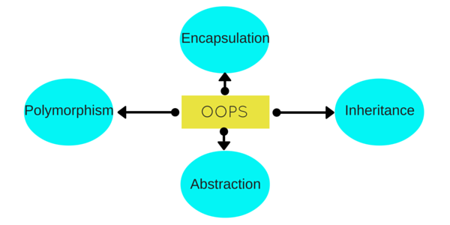
OOPS Concepts

Slide 19
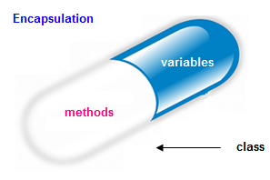
Key Concepts of OOPS
ENCAPSULATION: is a process of wrapping of data and methods in a single unit is called encapsulation, and that keeps both safe from outside interference and misuse
Ex:
Class Sample
{
private int x;
private show();
}

Slide 20
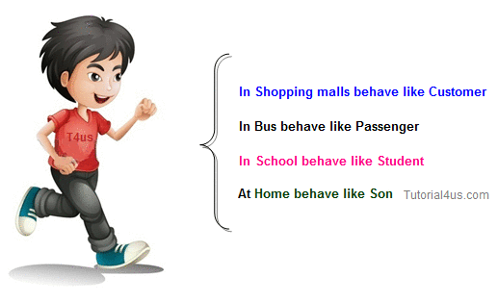
POLYMORPHISM
POLYMORPHISM is derived from 2 Greek words: poly and morphs.The word "poly" means many and "morphs" means forms.

Slide 21
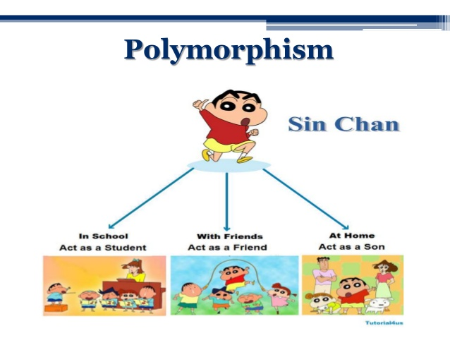

Slide 22
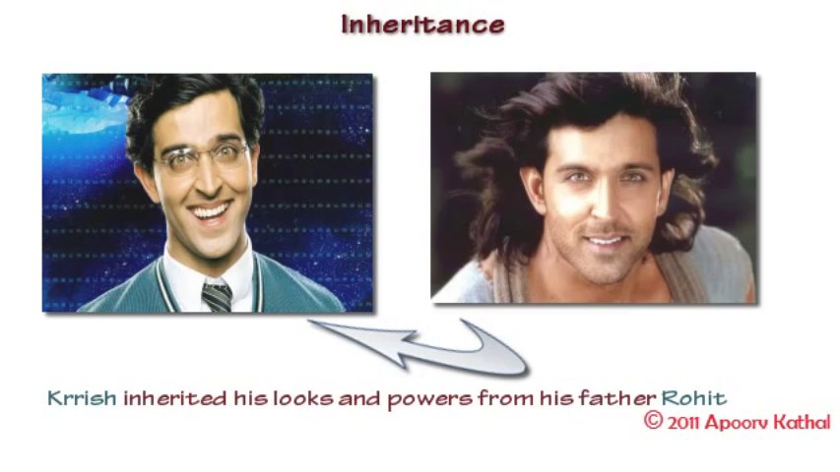
Inheritance
Inheritance: where one class acquires the properties (methods and fields) of another

Slide 23
The class which inherits the properties of other is known as subclass (derived class, child class) and the class whose properties are inherited is known as superclass (base class, parent class).

Slide 24
Data abstraction
Data abstraction providing only essential information to the outside world and hiding their background details, i.e., to represent the needed information in program without presenting the details.

Slide 25
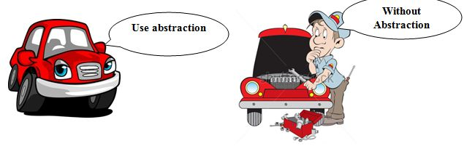
Example:

Slide 26
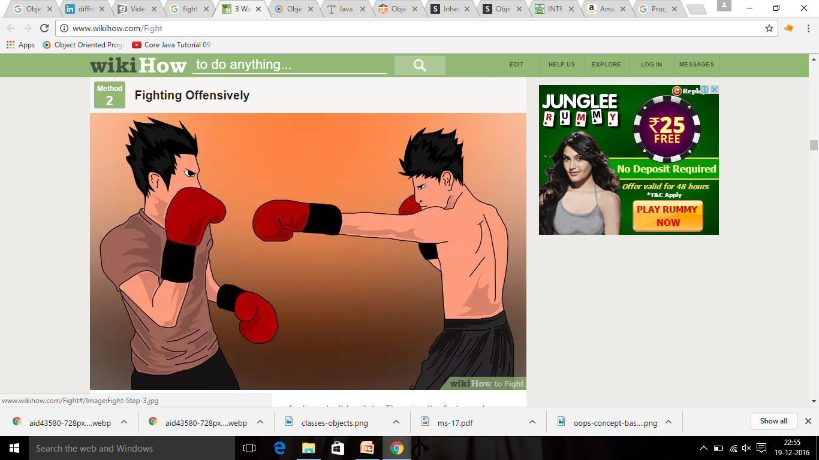
Object Oriented Programming vs. Procedural Programming
OOP
POP

Slide 27
Procedure Oriented Programming | Object Oriented Programming
In POP, program is divided into small parts called functions. | In OOP, program is divided into parts called objects.
In POP, Importance is not given to data but to functions as well as sequence of actions to be done. | In OOP, Importance is given to the data rather than procedures or functions because it works as a real world.
POP follows Top Down approach. | OOP follows Bottom Up approach.
POP does not have any access specifier. | OOP has access specifiers named Public, Private, Protected, etc.
In POP, Data can move freely from function to function in the system. | In OOP, objects can move and communicate with each other through member functions.

Slide 28
To add new data and function in POP is not so easy. | OOP provides an easy way to add new data and function.
To add new data and function in POP is not so easy. | OOP provides an easy way to add new data and function.
Example of POP are : C, VB, FORTRAN, Pascal. | Example of OOP are : C++, JAVA, VB.NET, C#.NET.

